Slide 1
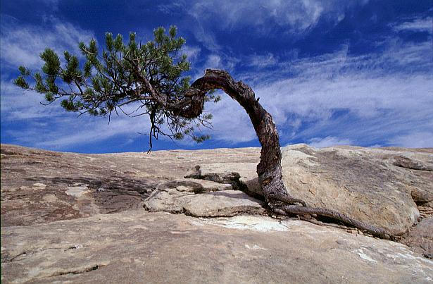
Plant responses to External Cues

Slide 2
Learning goals
Identify the functions of blue light receptors and phytochrome in plants
Explain photo-reversibility in phytochrome receptors

Slide 3

Plants use light for more than just energy production
As a cue for growth and development
Tracking time on daily and yearly cycles

Slide 4
Blue light receptors
Two types: crypto chromes and phototropins
Blue light initiates a range of responses in plants
Phototropism
Light-induced opening of stomata
Seedling growth regulation

Slide 5
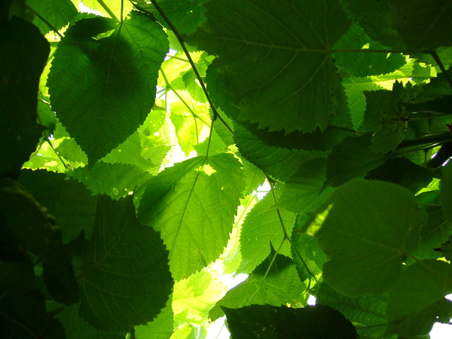
Photoreceptors
Red light receptors
Play roles in seed germination and shade responses

Slide 6
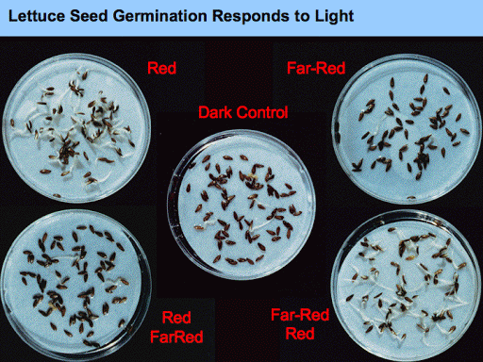

Slide 7
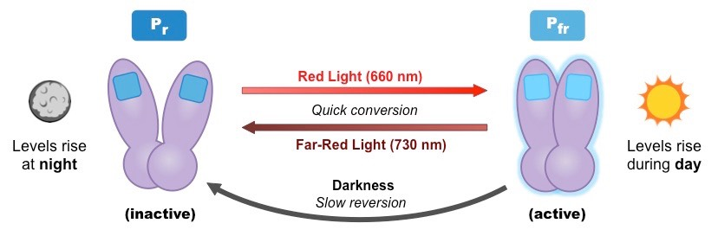
Phytochrome receptors are photo-reversible

Slide 8
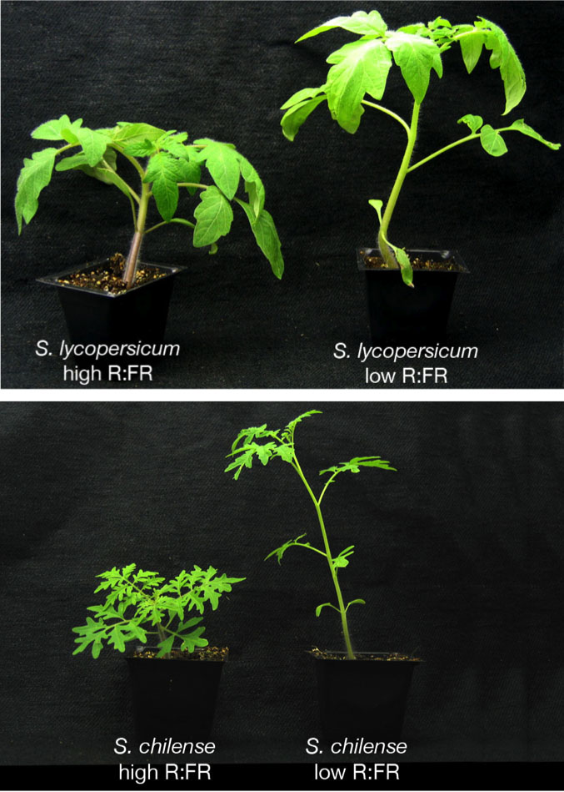
Responding to shade
When shaded, a plant detects less red light (R) and more far red (FR) light
Plant responds by allocating resources to increased height growth

Slide 9
Plant responses to External Cues

Slide 10
Learning Goals
Explain how plants respond to gravity
Distinguish between thigmomorphogenesis and thigmotropism

Slide 11
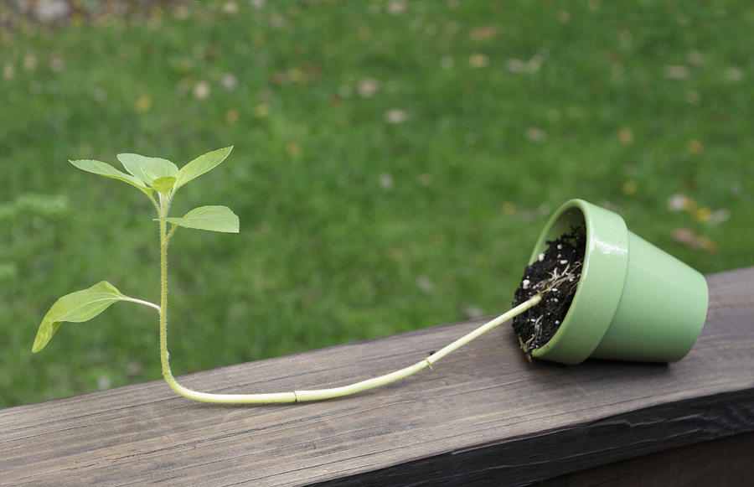
Plant responses to gravity
Roots display positive gravitropism
Shoots display negative gravitropism

Slide 12
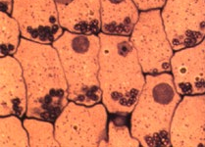
Statoliths
Dense cytoplasmic components that settle under the influence of gravity to the lower portions of a cell

Slide 13
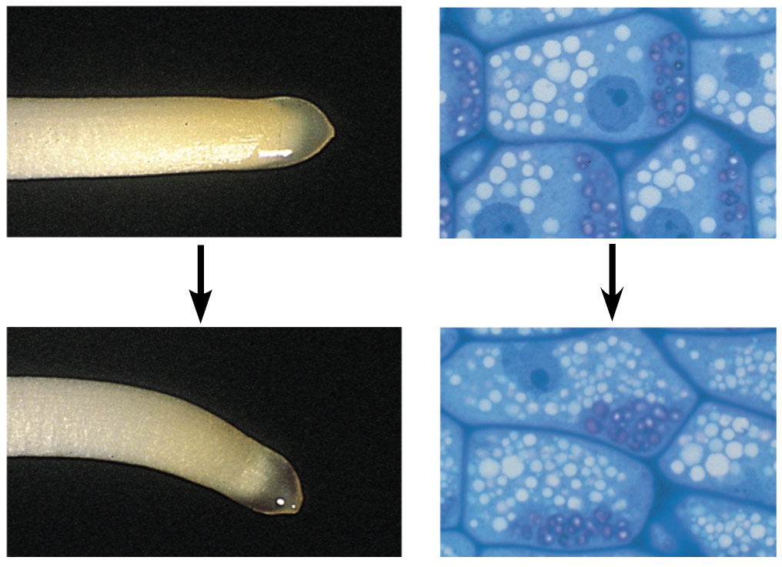
Statoliths

Slide 14
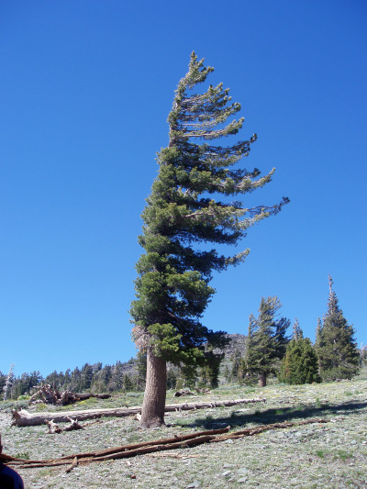
Response to mechanical stimuli
Thigmomorphogenesis - morphological changes that result from mechanical disturbance

Slide 15
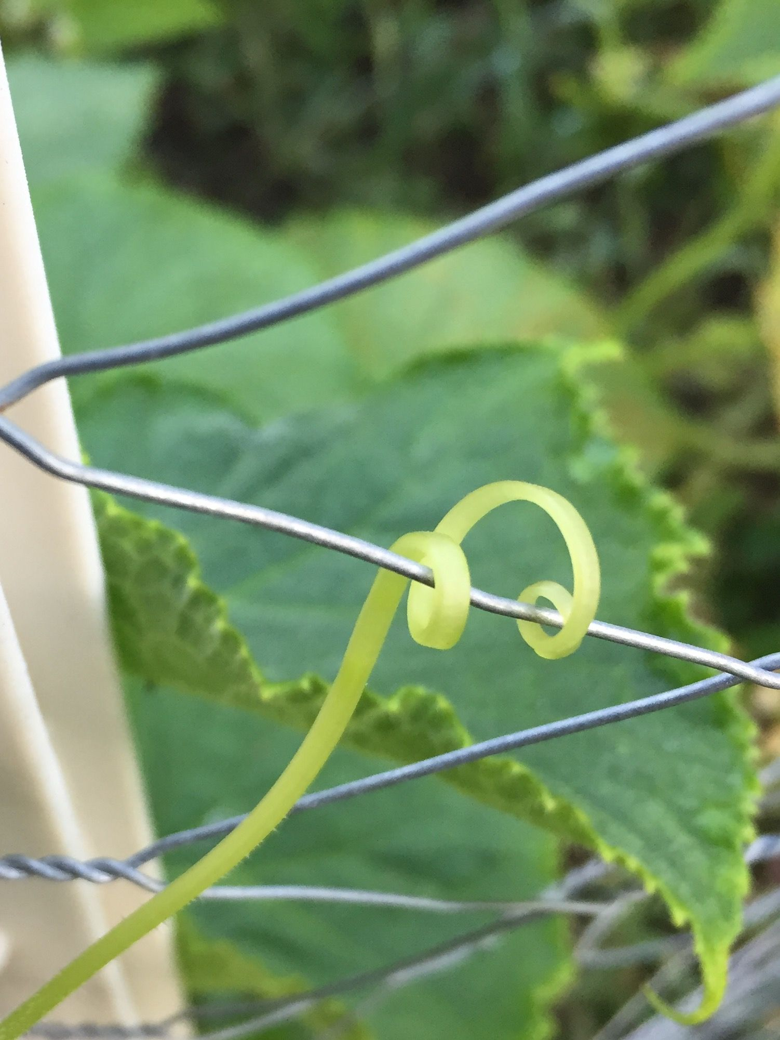
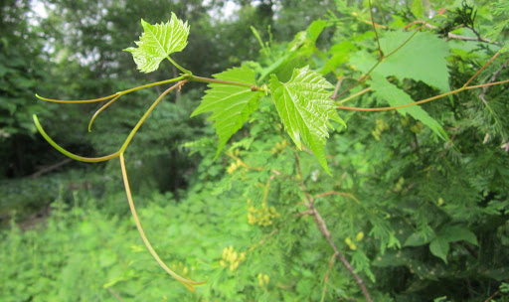
Some plants rely extensively on touch
Thigmotropism - directional growth in response to touch stimulus

Slide 16
Plant responses to External Cues

Slide 17
Learning Goals
Describe how plants are able to cope with stresses caused by drought, flooding, salt, and heat

Slide 18


Slide 19
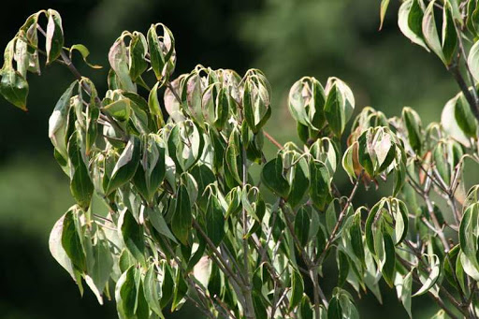
Drought stress
Plants reduce transpiration by closing stomata, producing abscisic acid, and reconfigure leaf shapes to reduce water loss

Slide 20
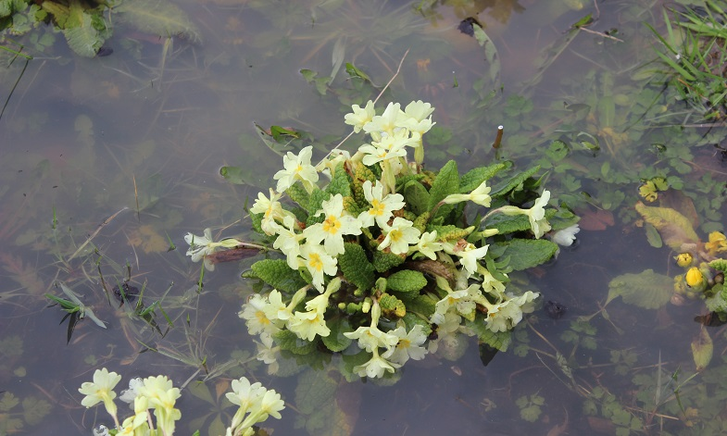
Flooding
Flooding creates anoxic conditions that impedes respiration, leading to a buildup of carbon dioxide in the roots

Slide 21
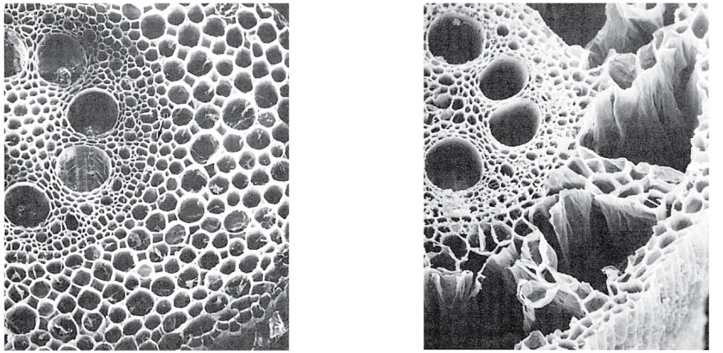
Plant Response to Flooding
Oxygen deprivation induces ethylene (hormone) production
Hormone causes cell death, and opens “air tubes” that provide oxygen to submerged roots
+
Control root
Oxygen deprived root

Slide 22
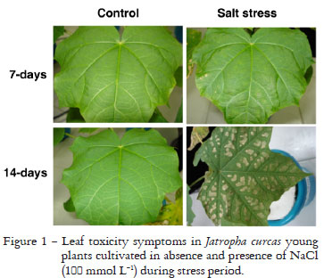
Salt stress
Saline soils present two problems
Lower water potential of soil
Toxicity
Plants produce intracellular solutes to temporarily lower cell water potentials

Slide 23
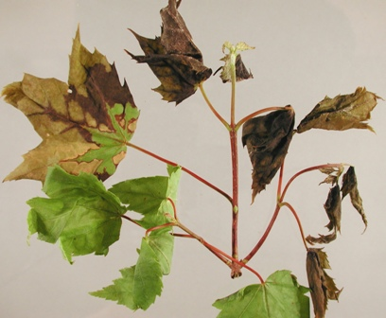
Heat stress
Excessive heat (> 40ºC) denatures enzymes and other proteins
Heat shock proteins are synthesized - these chaperone proteins keep other proteins from denaturing

Slide 24
Plant responses to External Cues

Slide 25
Learning Goals
Compare and contrast PAMP-triggered immunity and effector-triggered immunity.
Explain two types of effector-triggered immunity.

Slide 26
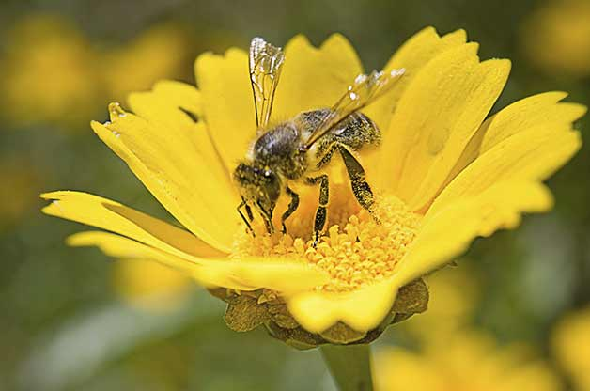
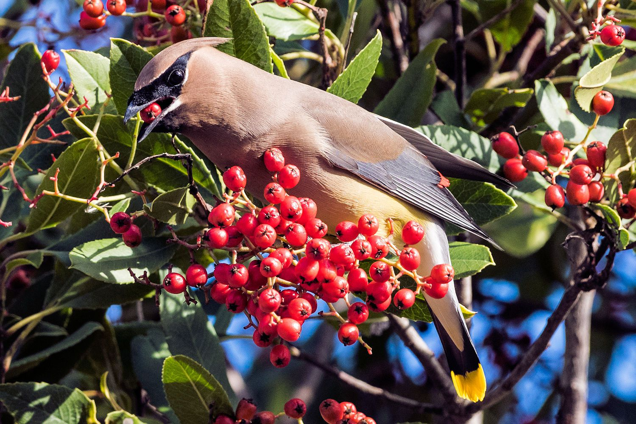
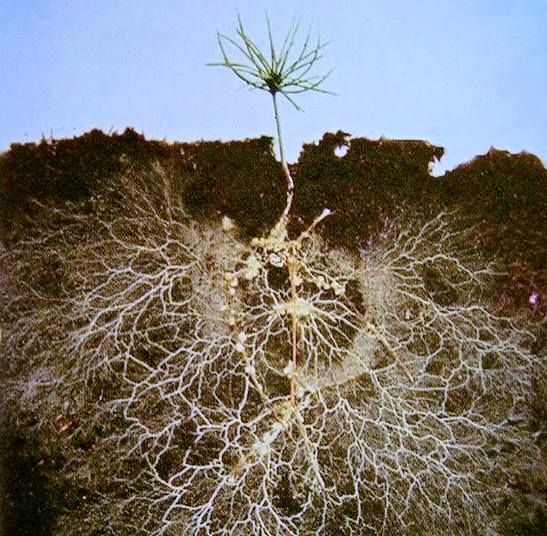
Beneficial interactions between plants and other organisms
Pollination
Seed dispersal
Mycorrhizal associations

Slide 27
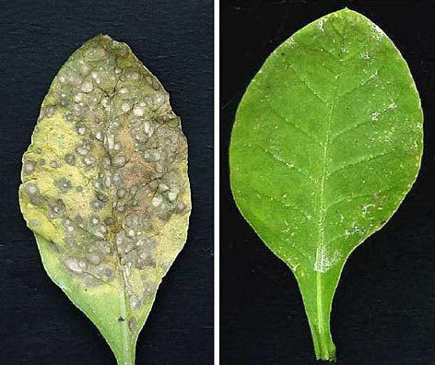
Plants are attacked by a range of organisms
Bacteria
Fungi
Viruses
Herbivores

Slide 28
Defenses against pathogens: PAMP-triggered immunity
Pathogen-associated molecular patterns (PAMP) (like flagellin)
Plant responds by producing broad-spectrum antimicrobial chemicals

Slide 29
Defenses against pathogens: Effector-triggered immunity
Pathogens evolved traits allowing them to bypass PAMP-triggered immunity
These pathogens secrete proteins called effectors into the cells of their host
Plants have counter-evolved plants effector-triggered immunity

Slide 30
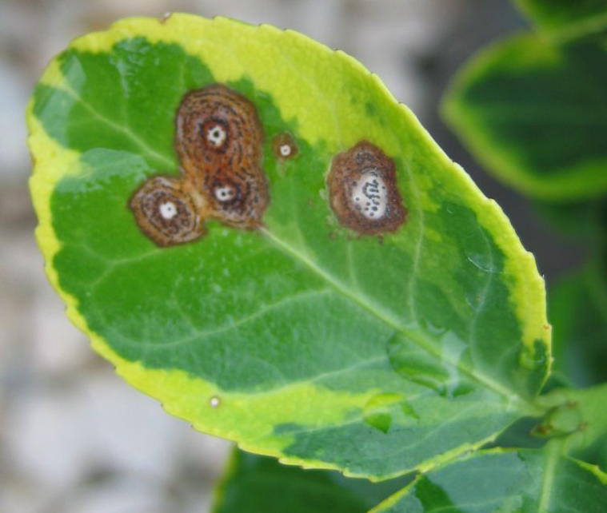
Effector-triggered immunity: the hypersensitive response
Localized cell death at the point of infection

Slide 31
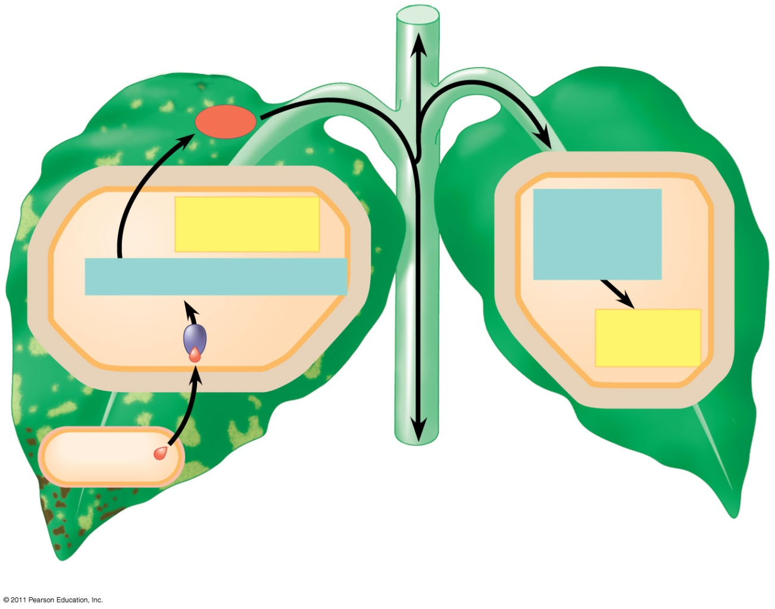
Effector-triggered immunity: systemic acquired resistance
Signaling molecule called methyl-salicylic acid is produced around the site of infection in response to effector
It travels through the phloem and is converted to salicylic acid away from the infection site
Salicylic Acid
Signal
Hypersensitive response
Signal transduction pathway
R-Avr recognition and hypersensitive response
Signal transduction pathway
Acquired resistance
Avr effector protein
R protein
Avirulent pathogen
Systemic acquired resistance

